Slide 2
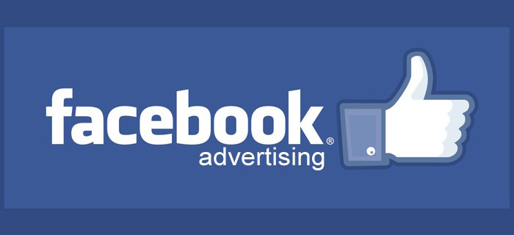
Lunchtime Learning Workshop

Slide 3
Mike Lamb
Krysta Paffrath

Slide 4
Please Turn Off Your Cell Phones
Eat Your Lunch
Make Notes
Hold Your Questions
Open Yourself to Advertising on FB

Slide 5
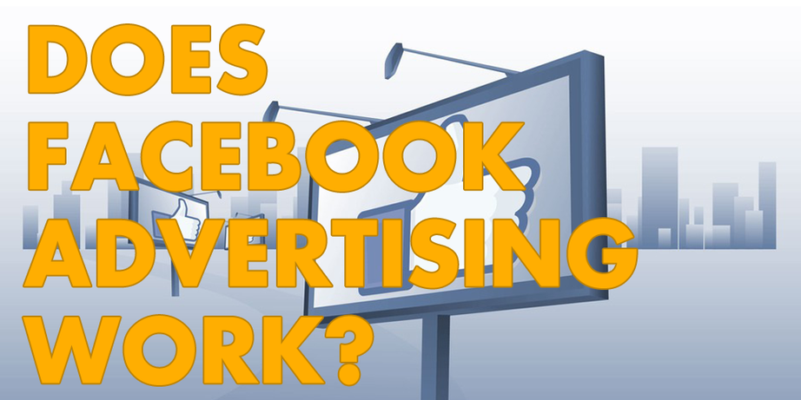
Let’s Find Out!

Slide 6
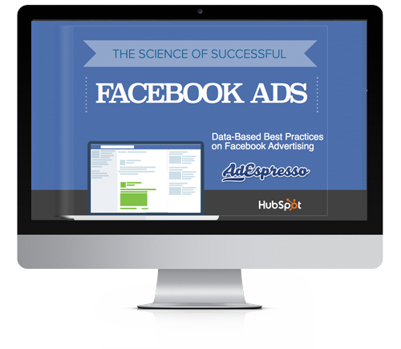

Slide 7
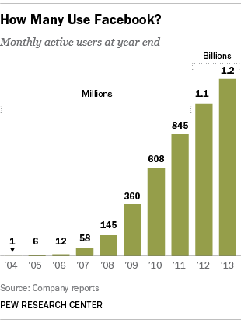

Slide 9
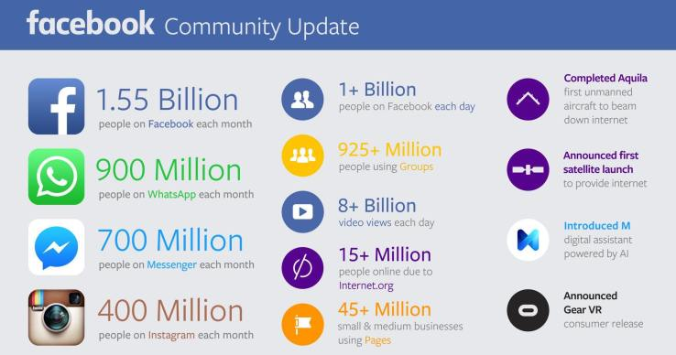

Slide 11
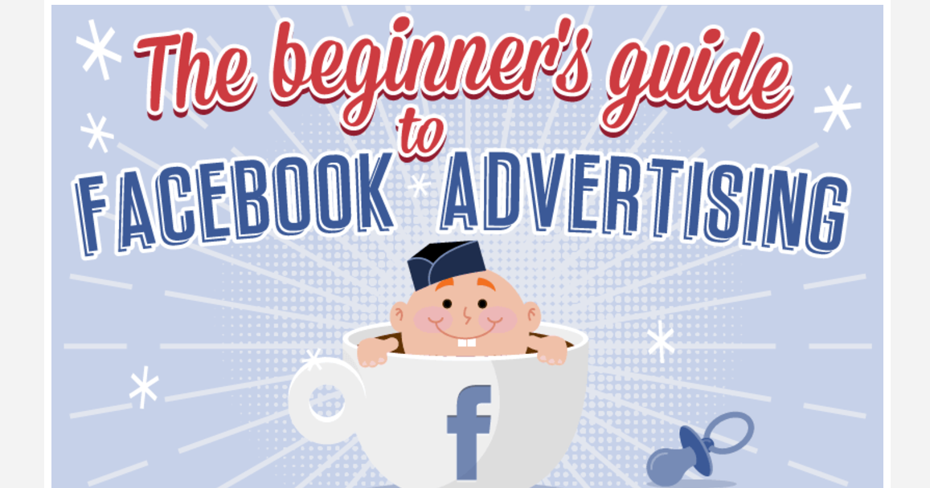

Slide 12
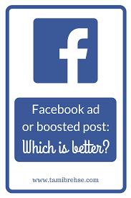

Slide 13
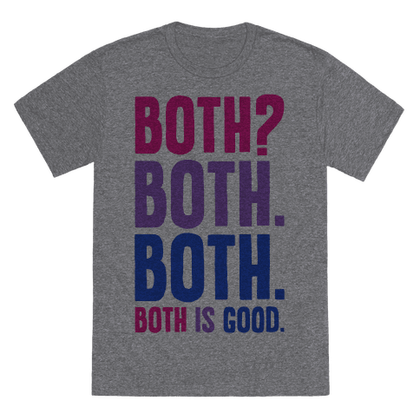

Slide 16
Boosting Your Posts
What’s Your Goal?
a. Brand Awareness
b. Sales Leads
c. Website Clicks

Slide 17
Boosting Your Posts
2. It’s About Content
Create engaging content that draws your readers in.
Content with images will ALWAYS do better than content without.

Slide 18
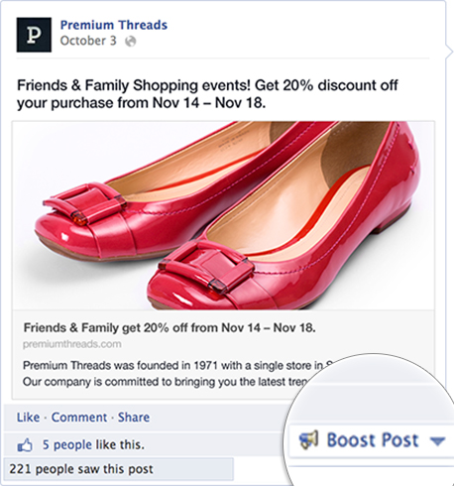

Slide 19
Boosting Your Posts
3. Boost Away!
Click the Boost Option on Your Post

Slide 20
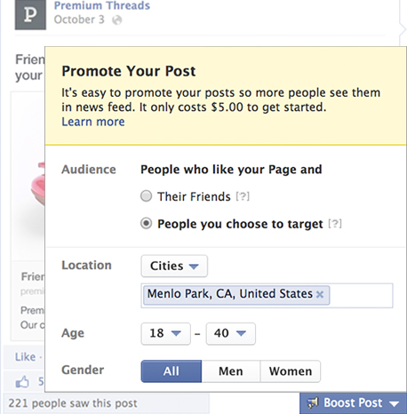

Slide 21
Boosting Your Posts
4. Who’s Your Audience
Pick who will see your post. A great way to reach potential new customers.
When you select “People you choose through targeting”,you can target people by location, age, gender and interests. (More on that later)

Slide 22
Boosting Your Posts
5. What’s Your Budget
Boosting a post is great way to reach your audience without breaking the bank.
Your time and budget
c. Billing

Slide 23
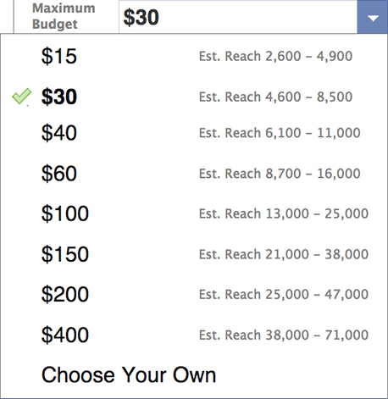

Slide 24
Boosting Your Posts
6. Measure Your Results
Page Insights
Engagement is one of the best things you can measure
ROI vs. ROR

Slide 27
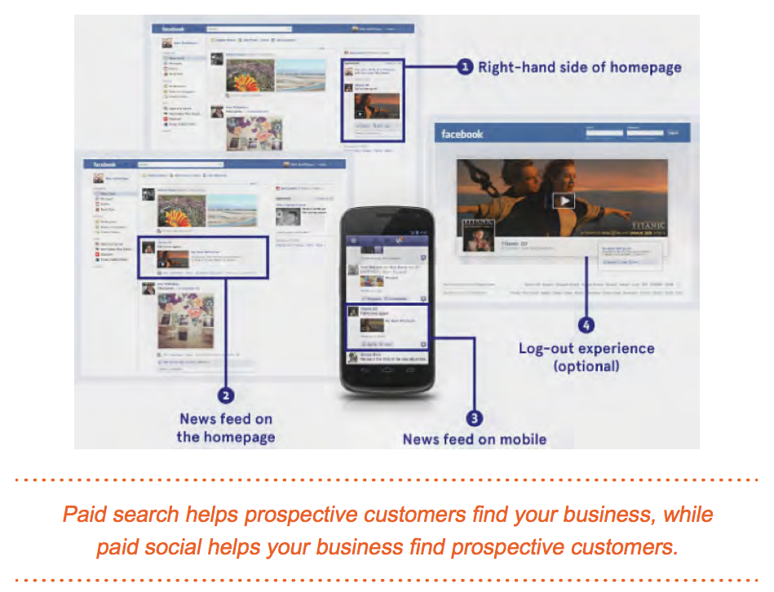

Slide 28
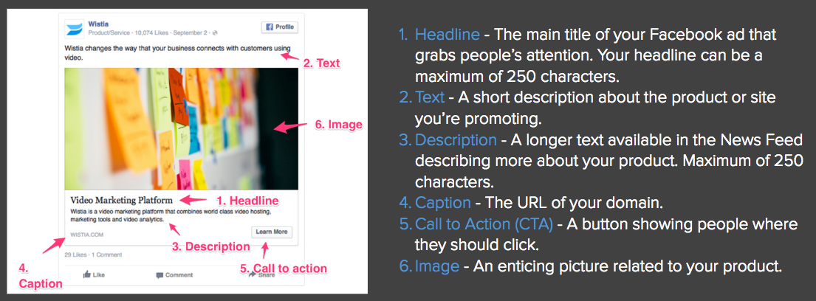
Six Components of a Facebook Ad

Slide 29
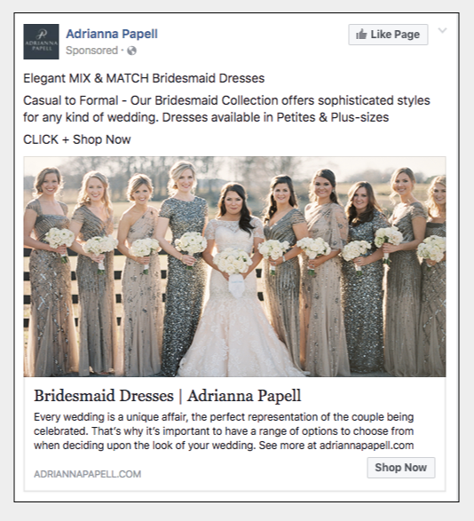

Slide 30
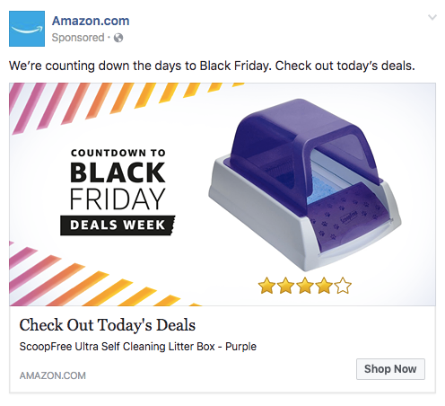

Slide 31
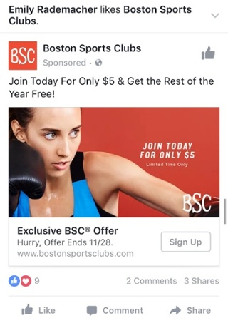

Slide 32
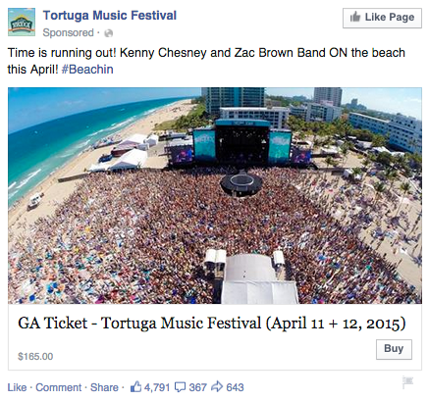

Slide 33
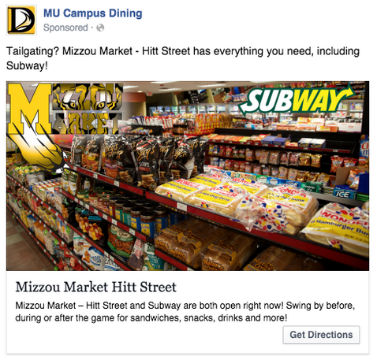

Slide 34
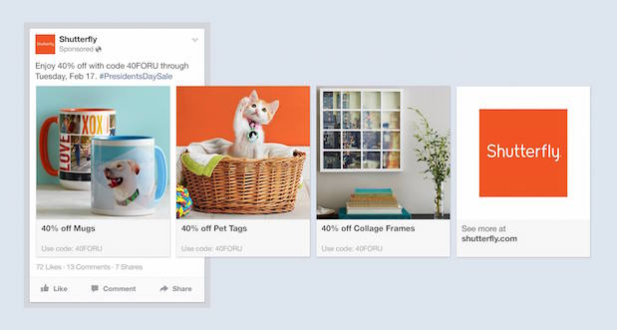

Slide 35
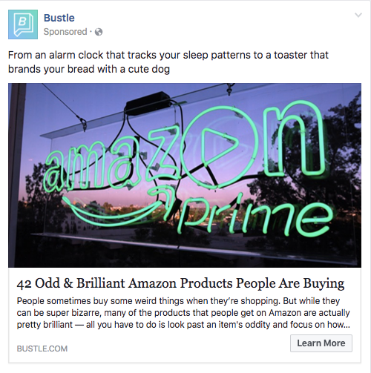

Slide 36
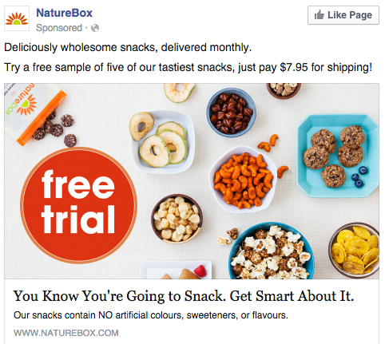

Slide 37
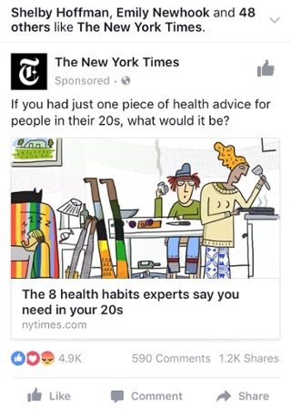

Slide 38
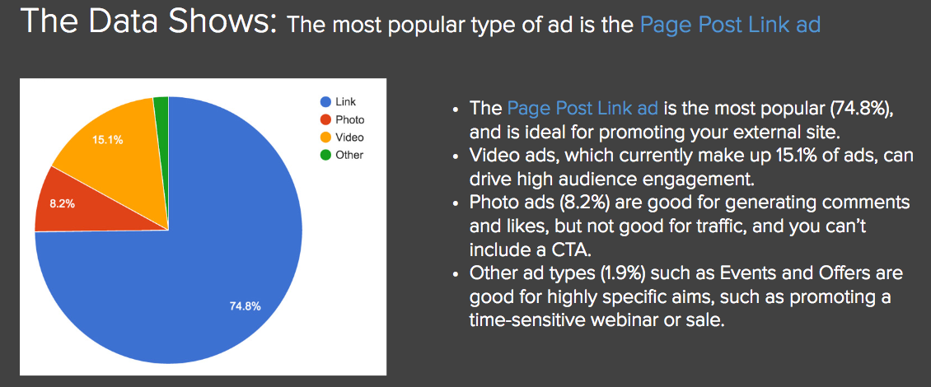

Slide 43
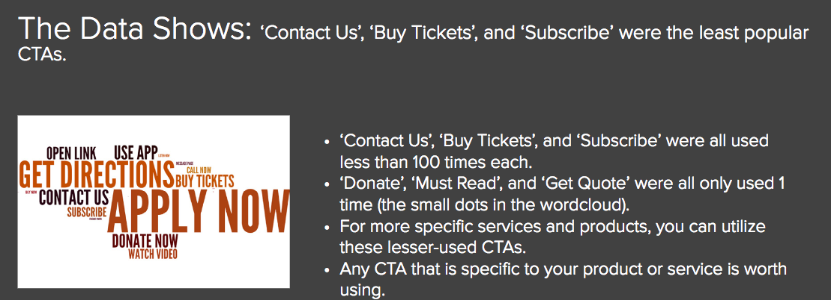

Slide 45
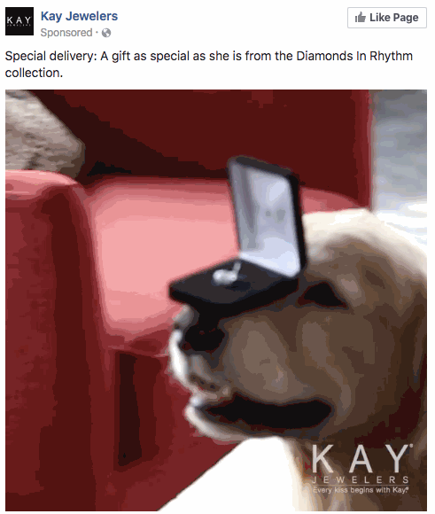

Slide 64
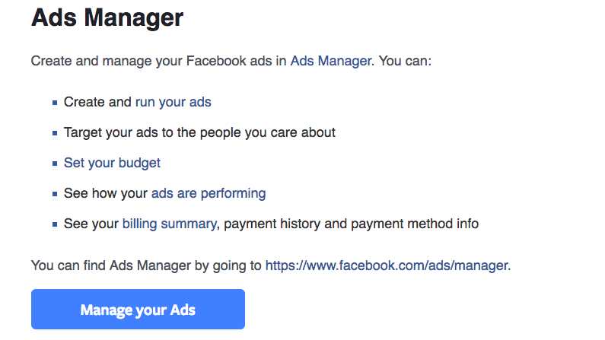

Slide 65
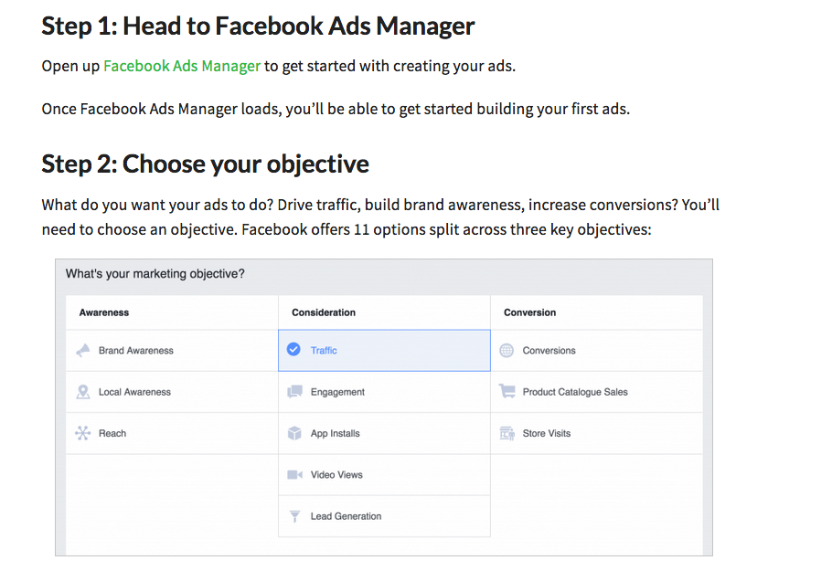

Slide 66
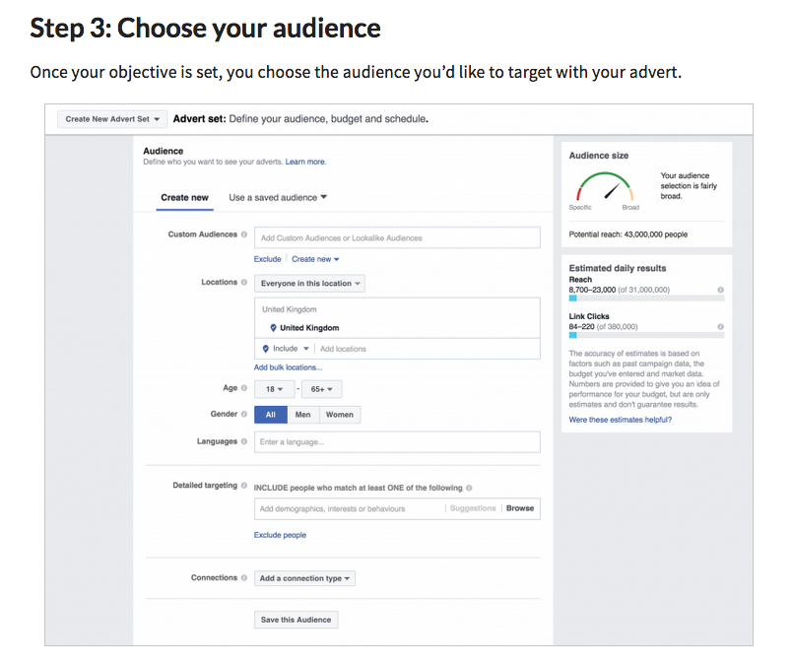

Slide 67
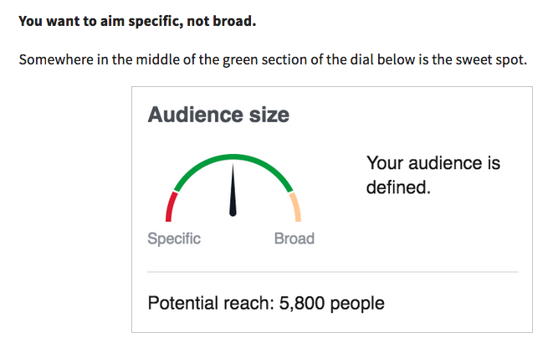

Slide 68
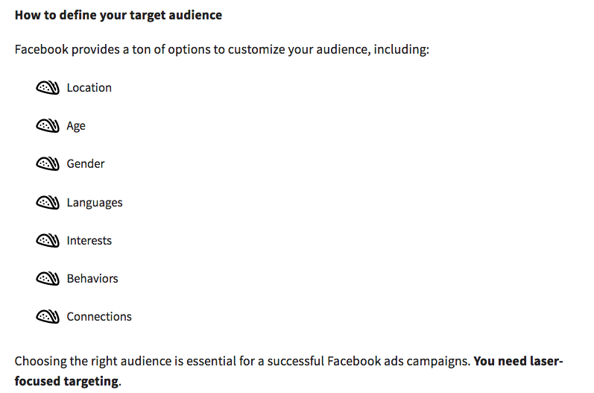

Slide 69
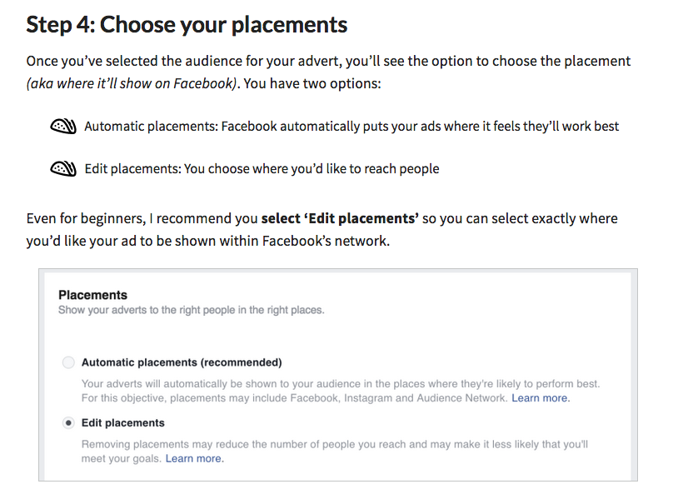

Slide 70
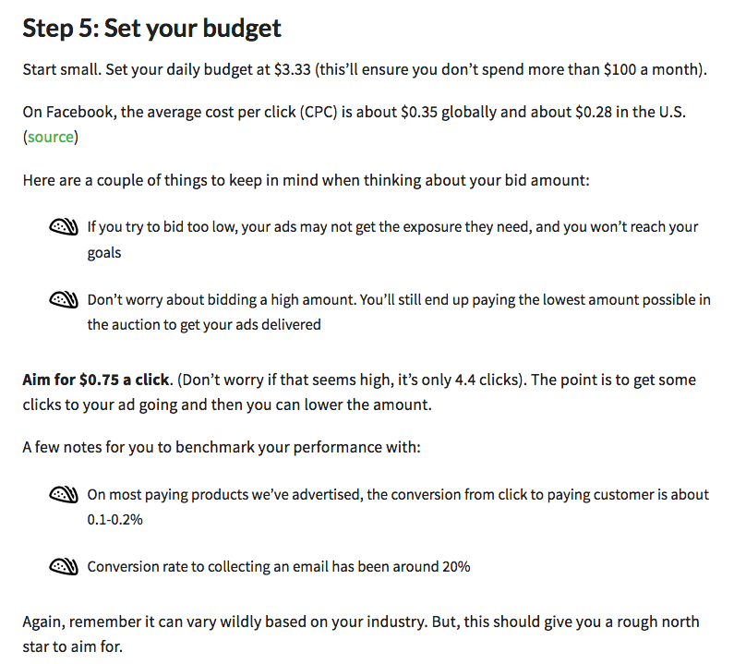

Slide 71
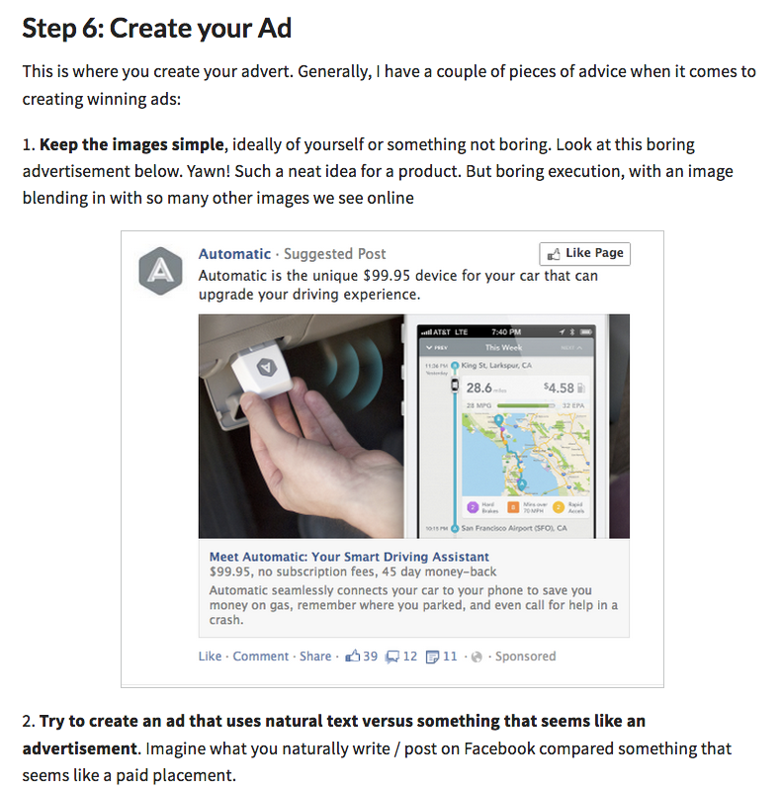

Slide 72
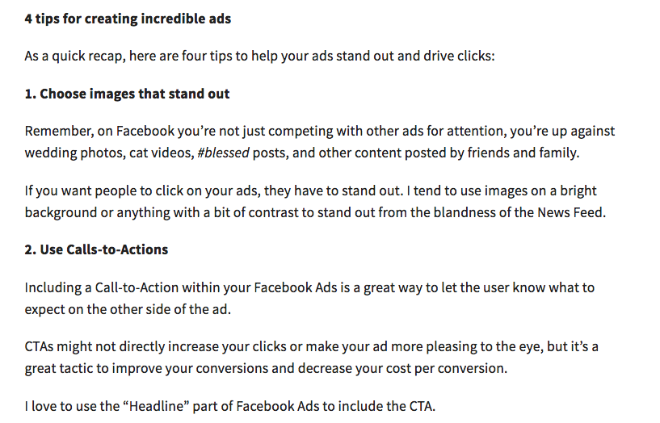

Slide 73
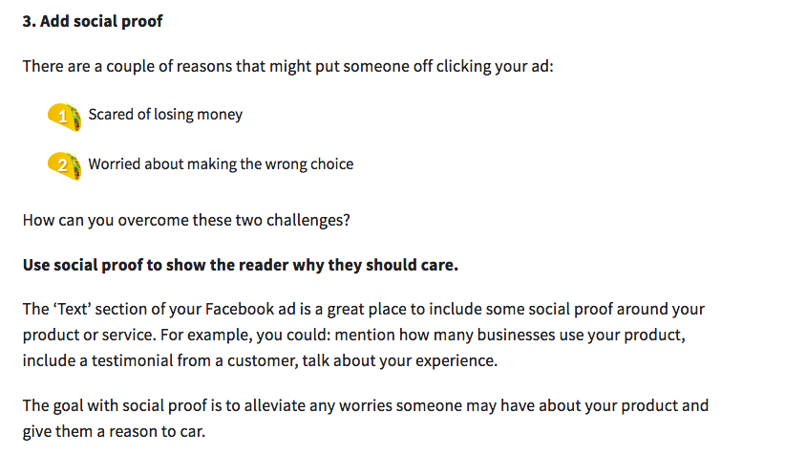

Slide 75
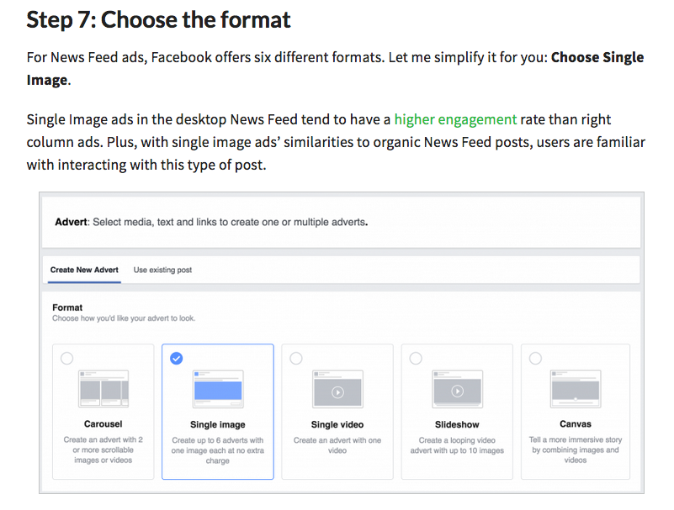

Slide 76
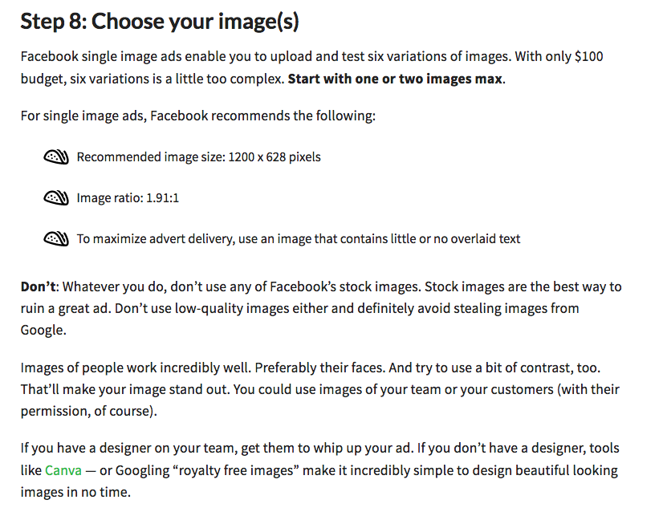

Slide 77
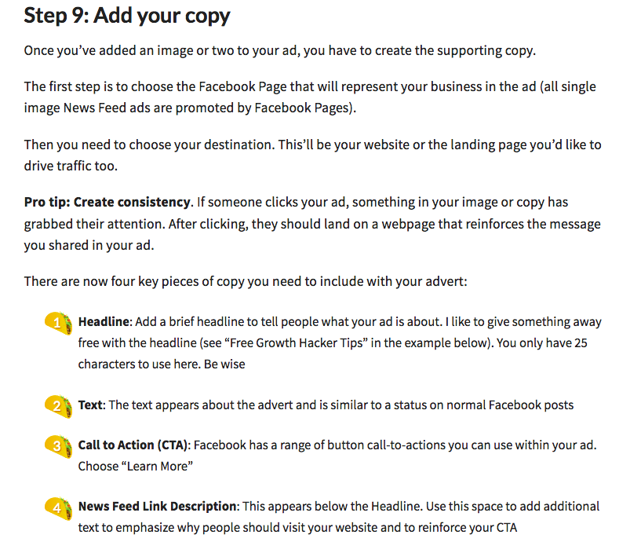

Slide 78
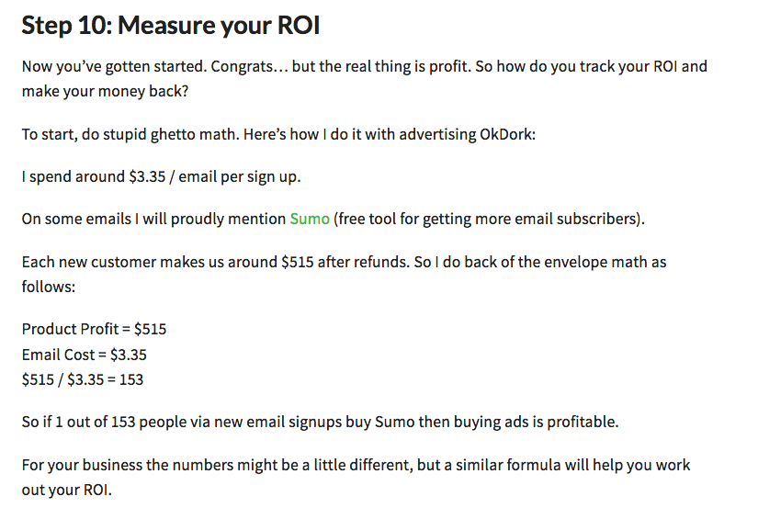

Slide 79
Six Components of a Facebook Ad

Slide 80
#1 POST USEFUL CONTENT When creating your Facebook Ads post an effective photo with a link to the content on your website. People don’t like to read long articles, therefore you need to grab their attention in 3 seconds that users will dedicating to you while scrolling through their Facebook Newsfeed.

Slide 81
#2 YOU NEED A CLEAR CTA The Call to Action is one of the most important things in advertising. You need to formulate a CTA, both in your text and in your advertising's headline. When formulating a call to action, you should always think this way “what?” & “when?”.

Slide 82
For example: “Buy Now!” or “Register Free today!” or "Become an expert in less than a week!”. In addition to these, Facebook offers you some Call to Action options to add to your ad, like “Install Now” or “Play Online Game”. You must choose the right option that is the most engaging and relevant to your product or service.

Slide 83
#3 BUILDING YOUR BRAND ON FACEBOOK When creating an ad, you need to speak to the user. Your reader needs to feel as if you are speaking only to them and not to a group of people. It is effective practice to use for example the word “your” or “you” in the ad headline: “Collect YOUR gift today”.

Slide 84
#4 EMPHASIZE WITH CAPITAL LETTERS Capital letters can help emphasize a particular feature, and guide the reader’s attention to it. For example: “Grab your Free gift now”. In this case, the word “Free” stands out over the others and will catch the user’s attention.

Slide 85
#5 ENGAGING WITH EMOJIS Colorful Emojis are another great way to enhance your ads and to catch users’ attention visually. Use them in your Facebook ads in order to maximize ROI and improve social media engagement!

Slide 86
#6 USE POWERFUL CREATIVES Be 100% sure to have good creatives in order to rock your ROI! Users’ attention span is very limited, so make sure to catch their attention with something different from the competition.

Slide 87
#7 MEASURE THE SUCCESS OF YOUR FACEBOOK AD CAMPAIGNS How much will Facebook ads cost ? A lot of factors directly or indirectly affect the cost of your Facebook Ads. How much your ads will actually cost and how much you’ll get for what you pay depends on what you want to spend and how much you track your audience. While ad cost and ad spend is important, what’s more important is the CPA and your ROI.

Slide 88
Thank You!

Slide 89
Any Questions?

